Slide 1
Video Game Recommendation System
Alvince Pongos
Joseph Lee
Joseph Barbati
Notes:
LEE

Slide 2
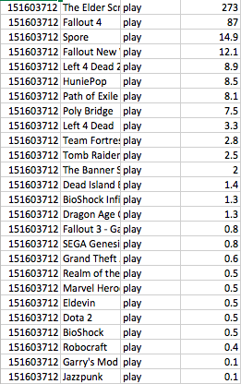
Datasets
Steam Video Games
4 attributes (player_id, game, action, hours)
Player_id -- unique
Game -- name of game
Action -- either play or purchase
Hours -- continuous
Notes:
LEE

Slide 3
Datasets
Game Features
78 attributes
We only care about the attributes that designate genre
13 attributes regarding genre, all TRUE or FALSE.
Notes:
LEE

Slide 4
Data Preprocessing
Steam Video Games
Data Reduction
We decided we didn’t care about ‘purchase’ (DLC, redundant, etc)
Removed any tuple with action == ‘purchase’
Game Features
Data Reduction
We removed any attributes that didn’t relate to name of game or genre
Reduced to 14 attributes

Slide 5
Data Preprocessing
Combining Datasets
The goal when we found the game features dataset was to combine this with the steam dataset to have access to the genre of each game.
Wrote Python script to combine datasets, essentially if the video games names matched then add the two rows together.

Slide 6
Data Preprocessing
Creating Frequent Itemset Mining Dataset
We wanted to frequent itemset mine for our recommendation system.
Wrote another Python script to take Steam Video Games dataset and turn it into something we could perform Apriori on.

Slide 7
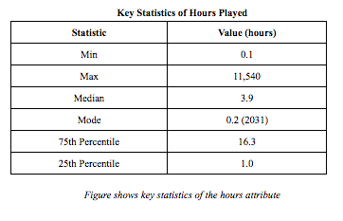
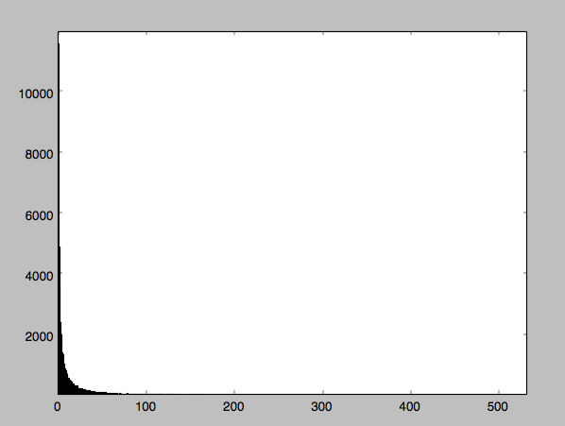
Key Statistics of Data
Frequency
Hours Played

Slide 8
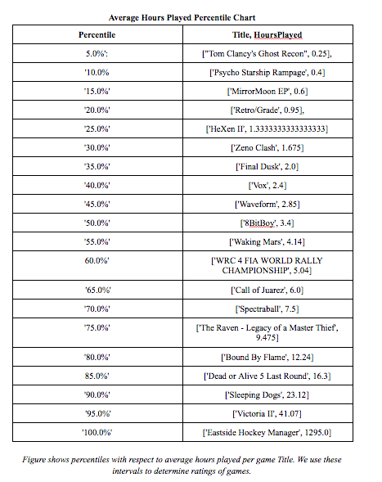
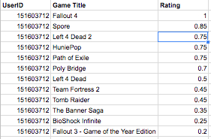

Slide 9
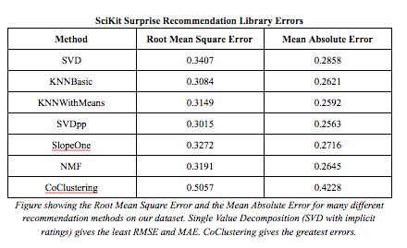
Errors of Different Recommendation Methods

Slide 10
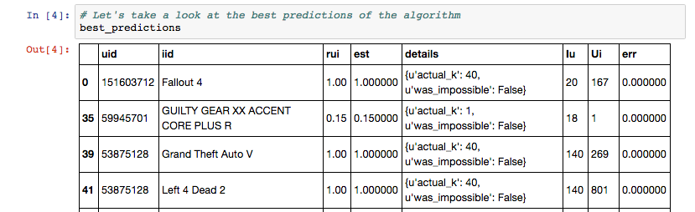
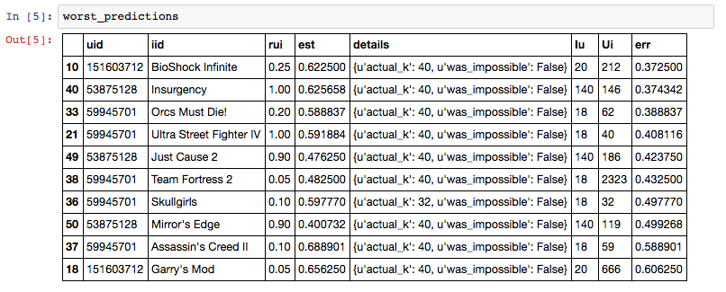
KNN Basic Best and Worst Predictions

Slide 11
How Are We Recommending?
By Similar Users
This is where the frequent itemset mining comes in.
Our program takes a list of games a user likes to play and uses that list and compares it to frequent itemsets.
Example:
User_Games = (X, Y, Z)
Example_FrequentItemset = (X, Y, Z, A)
We would recommend A (if avg hours played (correlated to avg user rating) is above a certain threshold). Jaccard Similarity with threshold.
Apply “weights” to recommended games by genre and title (more on that next)

Slide 12
DEMO

Slide 13
Dilemma
Weight Distribution:
Scale of applying the weight for Genres
Return games of any matching genres?
Return games of matching percentage?
More matching, higher weight scale?
Potential problem
Scale of applying weight for titles:
More characters match, higher weight?
Cut off point? First n character same weight, more than that, higher weight?
Notes:
LEE

Slide 14
Measuring Effectiveness
Training set: Combined dataset (Steam Video Games and Game Features)
Test set: Steam Video Games (with some random games removed)
We will see how many of the games we removed were recommended back to the user.
Measurement: Still deciding…
Sci-Kit Surprise uses Root Mean Square Error so we’re thinking of doing that to have a direct comparison
In order to do this, we would have to implement a rating prediction
Though we’re also considering precision and recall.
Precision -- Correctly recommended games / All recommended games
Recall -- Correctly recommended games / All games that should have been recommended.

Slide 15
Future Actions:
Improving the efficiency of recommendation system
Currently O(NMK)
N = length of input list
M = number of subsets in input list
K = number of frequent itemsets
Applying weights to recommended games
Notes:
LEE

